Slide 1

FruityTech
Studio
Group 15
Kanstansin Nechyparenka - Project Manager & Gameplay Engineer
Logan Jordan - UI/UX Engineer
Allam Syahriza - Audio Features Engineer

Slide 2
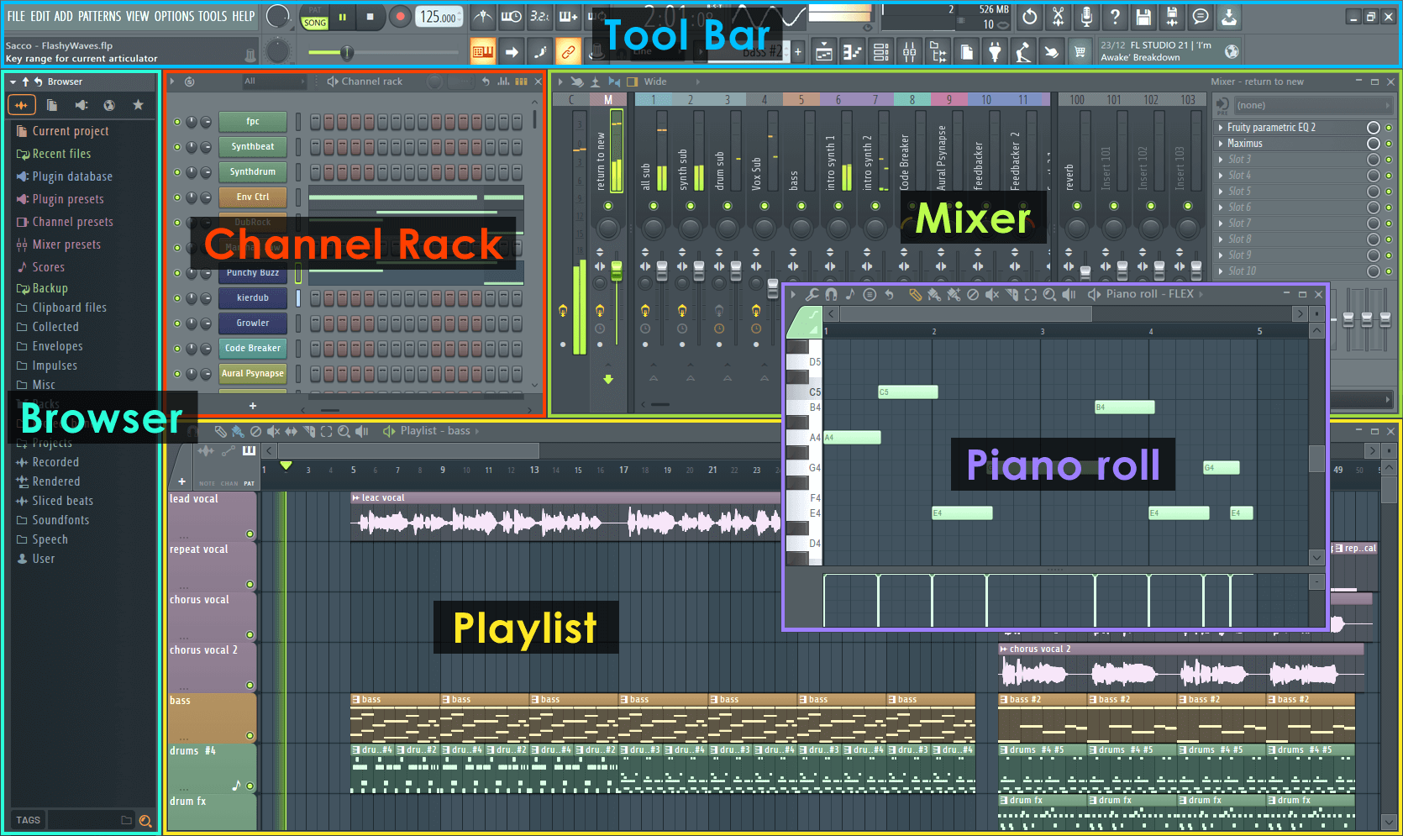

What Problem Are We Solving?
Getting into music production can be daunting.
Traditional digital audio workspaces (DAWs) are not beginner friendly
They have complicated UIs, steep learning curves, are expensive
Hard to use without previous background knowledge (music theory, or of similar programs)

Slide 3
Project Goal
Our goal is to make music creation beginner-friendly.
We want our tool to be as fun and intuitive as possible.
Why?
Give people the chance to express themselves creatively
Be used as a tool for music education
Allow people to learn and transition to professional tools

Slide 4
Solution Overview
Our app will be a game-like music sandbox
Replaces complex DAW workflows with a simple
Users create music by simply placing sounds and looping them
Hints and tutorials will help users learn important music concepts

Slide 5
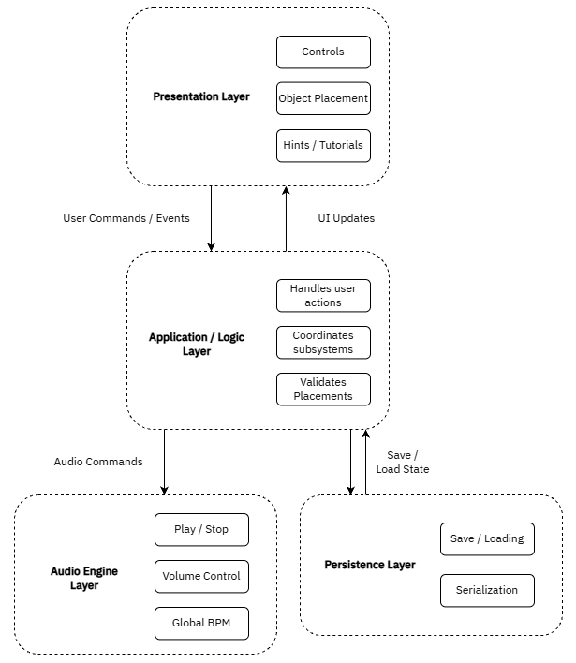
System Architecture
Consists of 4 main layers:
Presentation Layer
Application / Logic Layer
Audio Engine Layer
Persistence Layer
Notes:
The presentation layer
Contains all the UI elements
Only for the user to interact with, so it doesn’t at all handle audio playback, saving data, timing, etc

Slide 6
Core Design Decisions
Centralized Audio Manager
Single authority for timing and playback
Global Tempo Model
One BPM governs all sound objects
Deterministic DSP scheduling
Audio timed independently from frame rate
Notes:
At the core of the system is a centralized audio manager. Instead of each sound object controlling its own timing, all playback is scheduled through a single component. We also decided to have a global tempo so we’ll have one set BPM that will govern all the sound objects. We will also have deterministic DSP scheduling which means we will time our audio independently from the framerate, which is crucial for audio sync. These design decisions avoid timing drift and audio sync, which is our biggest risk.

Slide 7
Algorithms & Game Logic
Tempo-based scheduling algorithm
Converts BPM to beat and bar durations
Bar-aligned playback
Sounds start and stop at musical boundaries
Sound object lifecycle management
Register, update, remove audio sources
Real-time parameter updates
Volume, mute, and effect changes without desync
Placement & state validation
Prevents invalid interactions
Notes:
The system will convert BPM into exact time values such as seconds per beat and seconds per bar. When a user presses play or adds a sound, the audio manager schedules playback to begin at the next bar boundary. Each placed sound object is registered with the unity audio engine. The objects will have an AudioSource and will apply updates like volume or mute in real time, while staying synced with the global tempo. Placement validation happens at the game logic layer, ensuring that sound objects are only created in valid sandbox regions and that their parameters stay within allowed ranges.

Slide 8
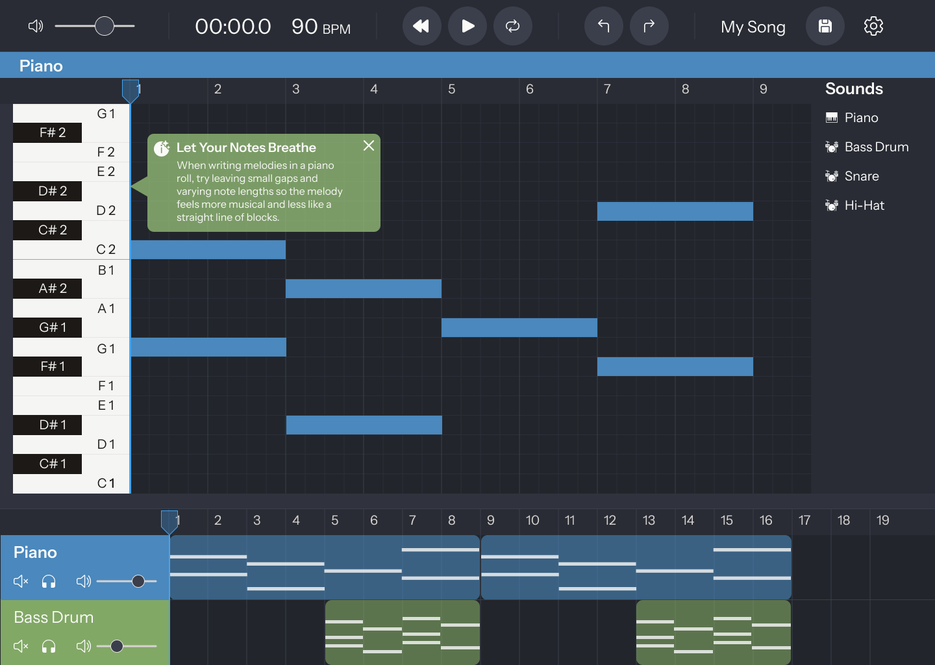
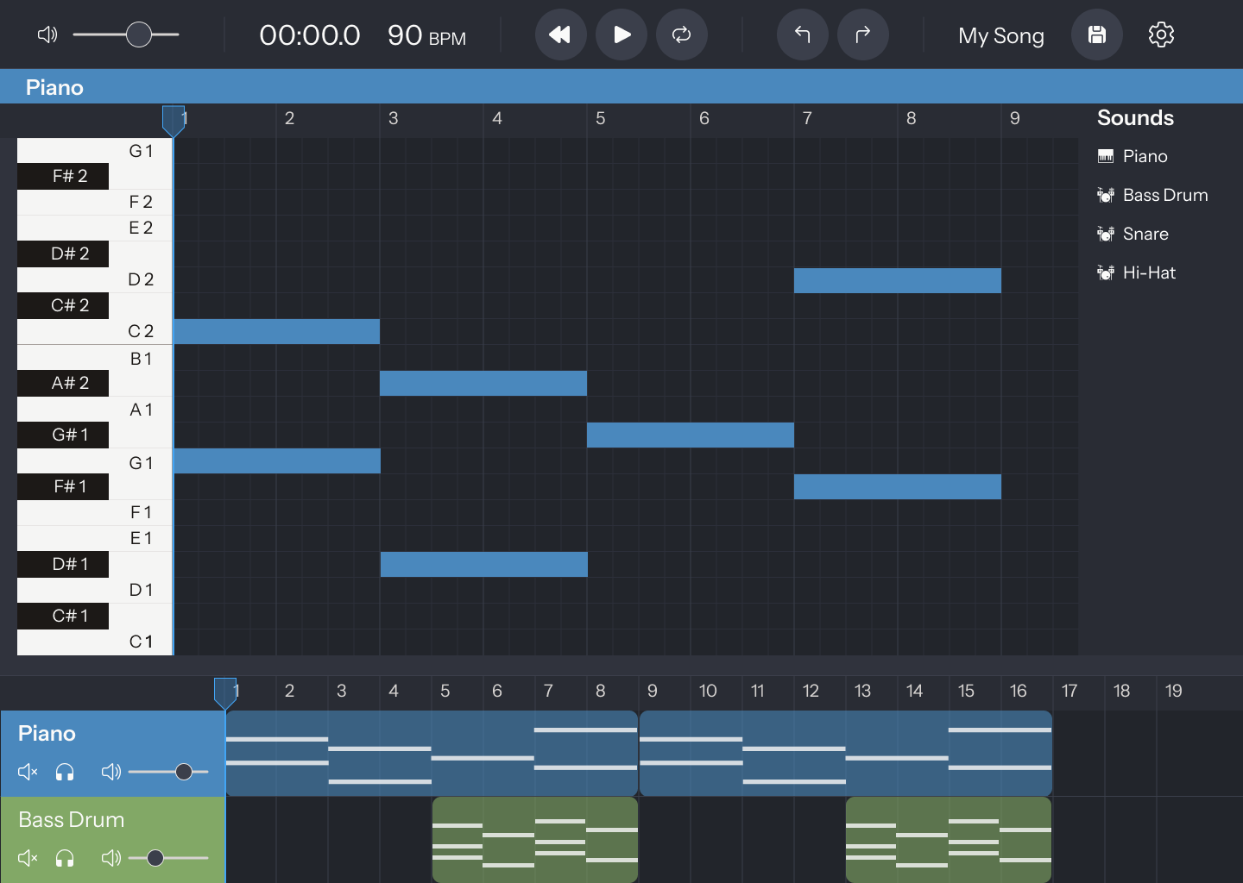
User Interface Design
Toolbar controls
Drag-and-drop sound palette
Piano roll sandbox
Timeline & track view
Educational hint popups
Notes:
The UI is designed to be user friendly while balancing approachability for beginners with useful control for more experienced users. The drag-and-drop sound palette is the entry point. Users can choose from preloaded sound objects, so there’s no need to import files or configure instruments. The piano roll acts as the main sandbox. Instead of a traditional timeline-first workflow, users visually place notes and loops, which makes rhythm and repetition easier to understand. The toolbar provides global controls like play/pause, global volume, looping, and saving. It also features time and BPM display. The timeline and track view give users more control once they’re comfortable. Each sound has its own track where volume, mute, and solo which can be adjusted without breaking synchronization.
Finally, educational hint popups will appear contextually. These help beginners understand how to use the tools and concepts like looping, tempo, and layering to start. These hints may also cover more advanced music theory concepts like harmony, rhythm, mixing, etc.

Slide 9
Educational Design
Learning through interaction
Concepts taught by doing, not reading
Contextual educational hint popups
Appear based on user actions
Beginner concepts
Looping and repetition
Tempo and timing
Layering sounds
Advanced concepts
Rhythm patterns
Harmony and melodic balance
Mixing basics (volume, mute, solo)
Notes:
FruityTech Studio is designed to teach musical concepts implicitly through interaction. Instead of tutorials or manuals, the system introduces concepts at the moment they become relevant. For example, when a user places their first sound object, a hint may explain looping. When multiple sounds are layered, a hint may introduce rhythm or balance. Educational hint popups appear contextually. They explain both how to use the tools and why certain musical ideas work. For example, a hint might explain how tempo affects looping, or why muting a track can help isolate rhythm. Beginners are introduced to core concepts like looping, tempo, and layering first. More advanced ideas such as harmony, rhythm patterns, and basic mixing are introduced gradually, so they don’t overwhelm new users. This approach allows the system to support learning without breaking the creative flow, making the experience both educational and enjoyable.

Slide 10
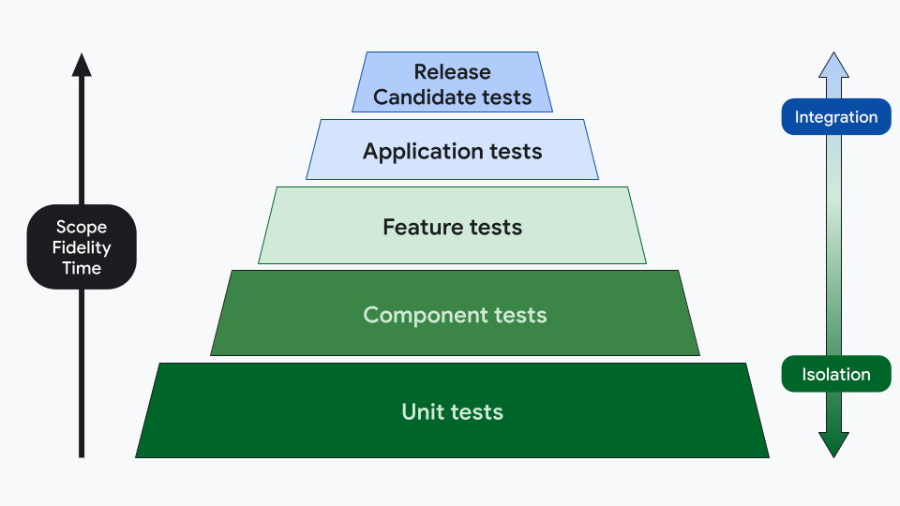
Testing & Evaluation
Unit Tests
Core logic and timing
Integration Tests
Full functionality testing/full workflows
Sync & Stress Tests
Program performance/long playback
Usability Playtest
Use cases

Slide 11
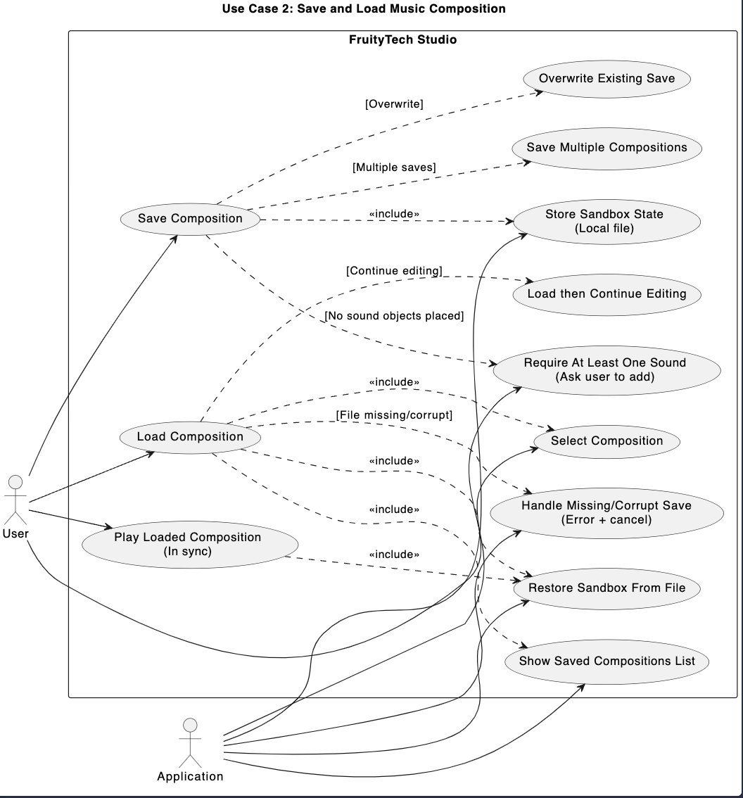
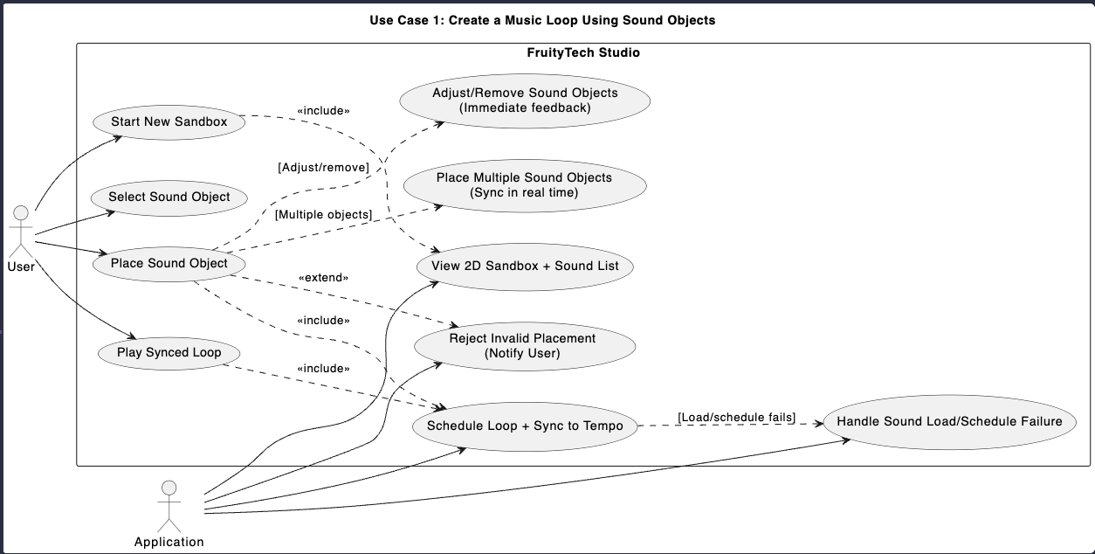
Primary Use Cases

Slide 12
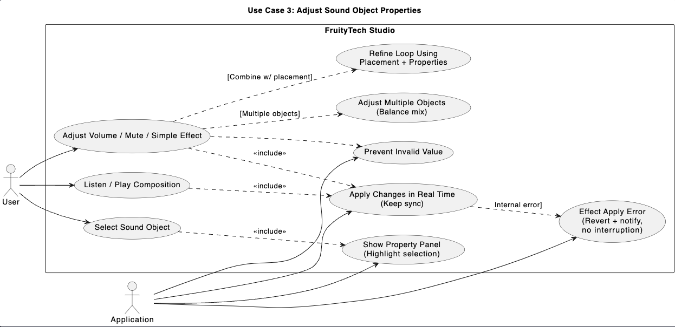
Primary Use Cases

Slide 13
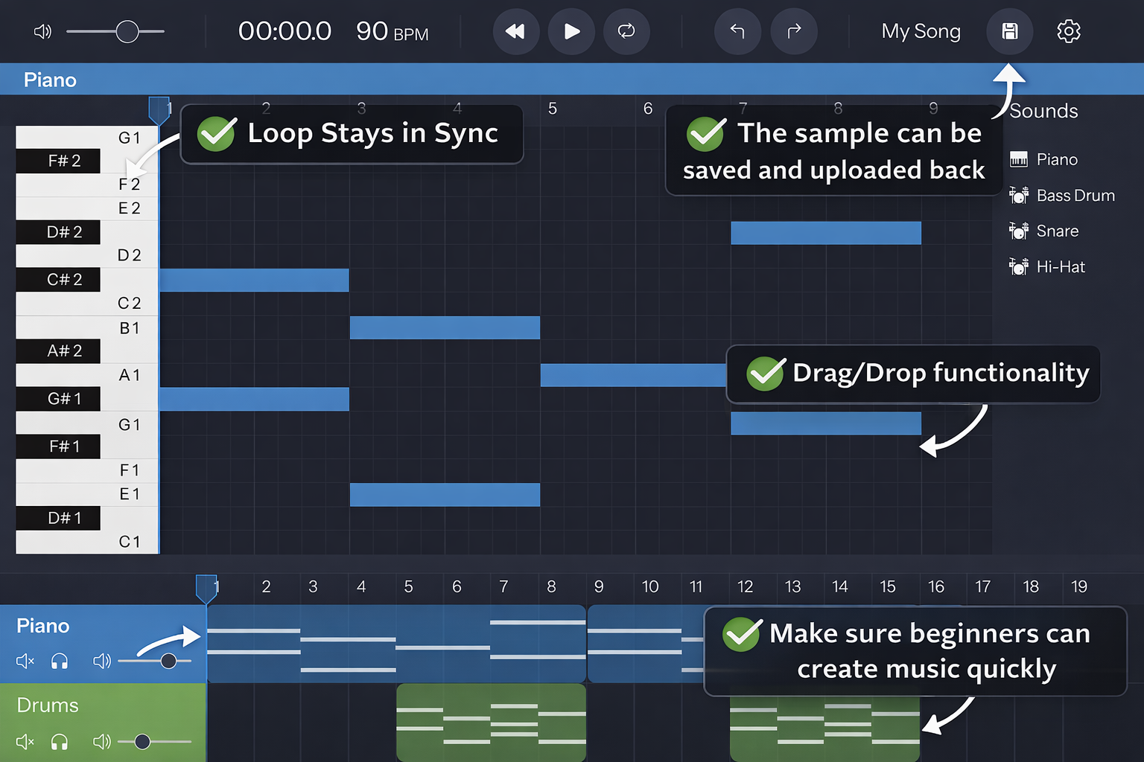
To prove the problem is solved…
… as well as code debugging, code functionality and effectiveness

Slide 14

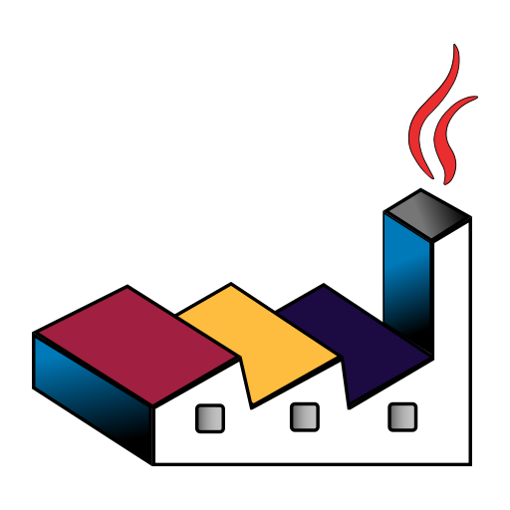


Tools
Issue Tracking & Project Management
GitHub Project
Github Issues
Validation and testing tools
Unity Test Framework
Unity Profiler
Usability & Documentation/Feedback
Google Docs
Google Forms
PlantUML

